Slide 1

Machine Learning Algorithms Linear and Logistic Regression
Raghu Prasad Konandur
9845547471
www.kaushalya.tech
raghuprasadkonandur@kaushalya.tech

Slide 2
Introduction
Raghu Prasad – BE, MS
Total of 29 years of experience
7 years as a lecturer in an Engineering College
22 Years into IT
Worked with companies like CISCO,CSC,ICICI,First Apex – NTT Data
Currently into Corporate training and consultancy
Worked with corporates and public sector
Service Offerings – In person/On-line/Corporate/Academic Institutes
Consultancy – Consultant to vendor of Atal Tinkering Lab/ECIL-ECIT, Incarnus – Healthcare Service Provider
Technologies – Java,Python,Web technologies,Java Script technologies (MEAN stack),IOT,Test Automation,Machine Learning,Artificial Intelligence,ERP,.NET
Customers – Philips,L & T,NextGen,Incarnus,Aspire system,BGS-IT,Sindhi College,Malnad Enginering College,S B College of Management, REVA University,Nagarjuna Engineering College,Dayanand Sagar University,Acharya Institute of Technology,NIE Mysore,NIT-Imphal,etc

Slide 3
Topics
Supervised machine learning
Linear Regression
Logistic Regression

Slide 4
Supervised Machine Learning
Supervised Learning
How it works: This algorithm consist of a target / outcome variable (or dependent variable) which is to be predicted from a given set of predictors (independent variables). Using these set of variables, we generate a function that map inputs to desired outputs. The training process continues until the model achieves a desired level of accuracy on the training data.
Examples of Supervised Learning: Regression, Decision Tree, Random Forest, KNN, Logistic Regression etc.

Slide 5
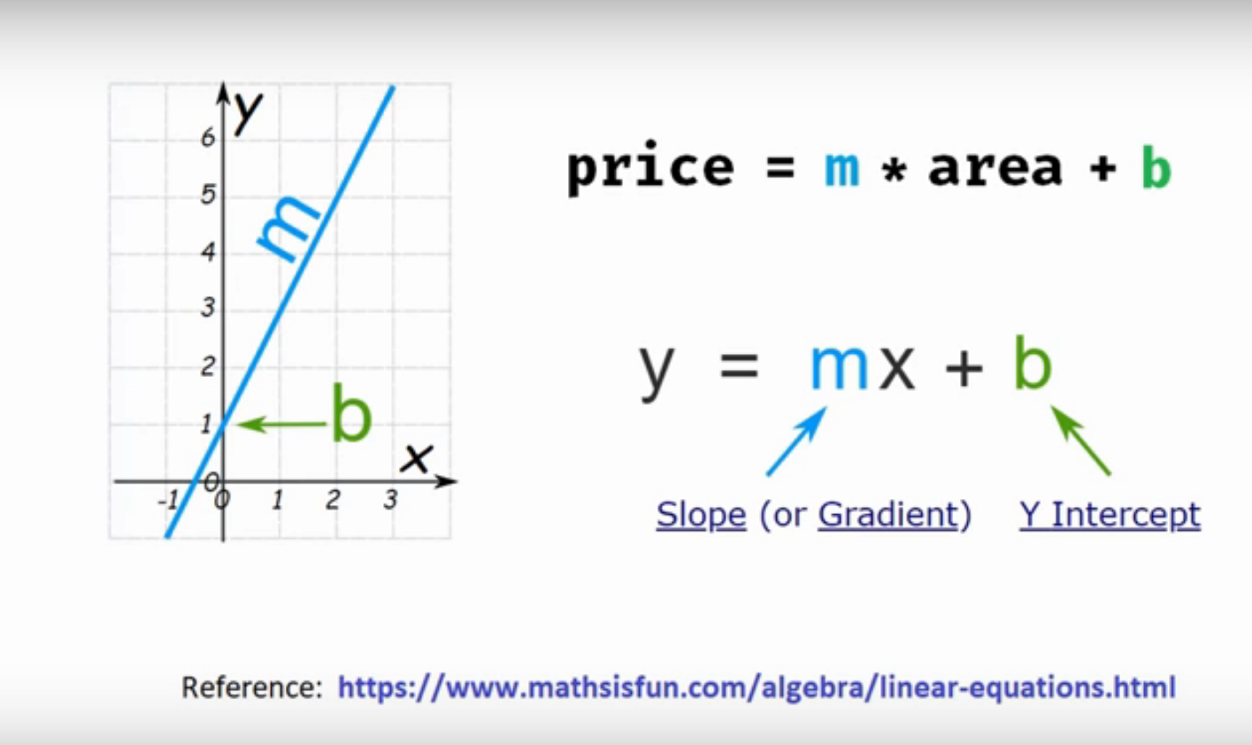
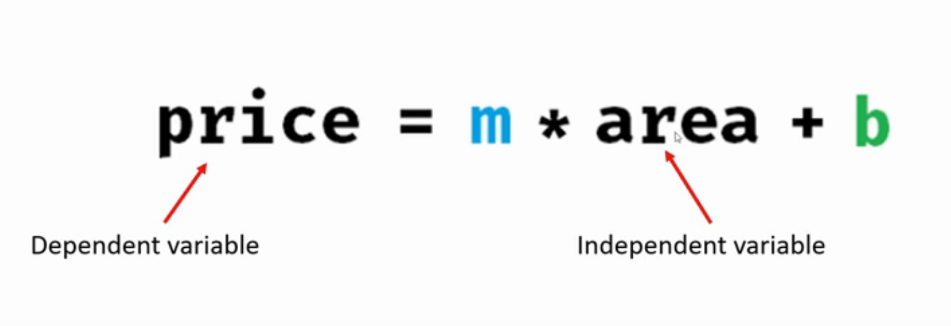
Linear Regression – Single Variable
Prediction of home price

Slide 6
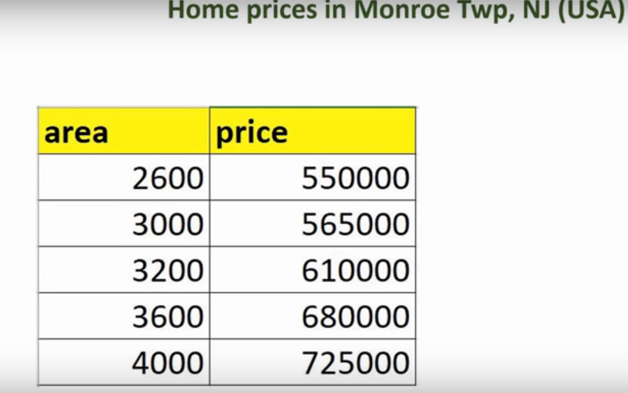
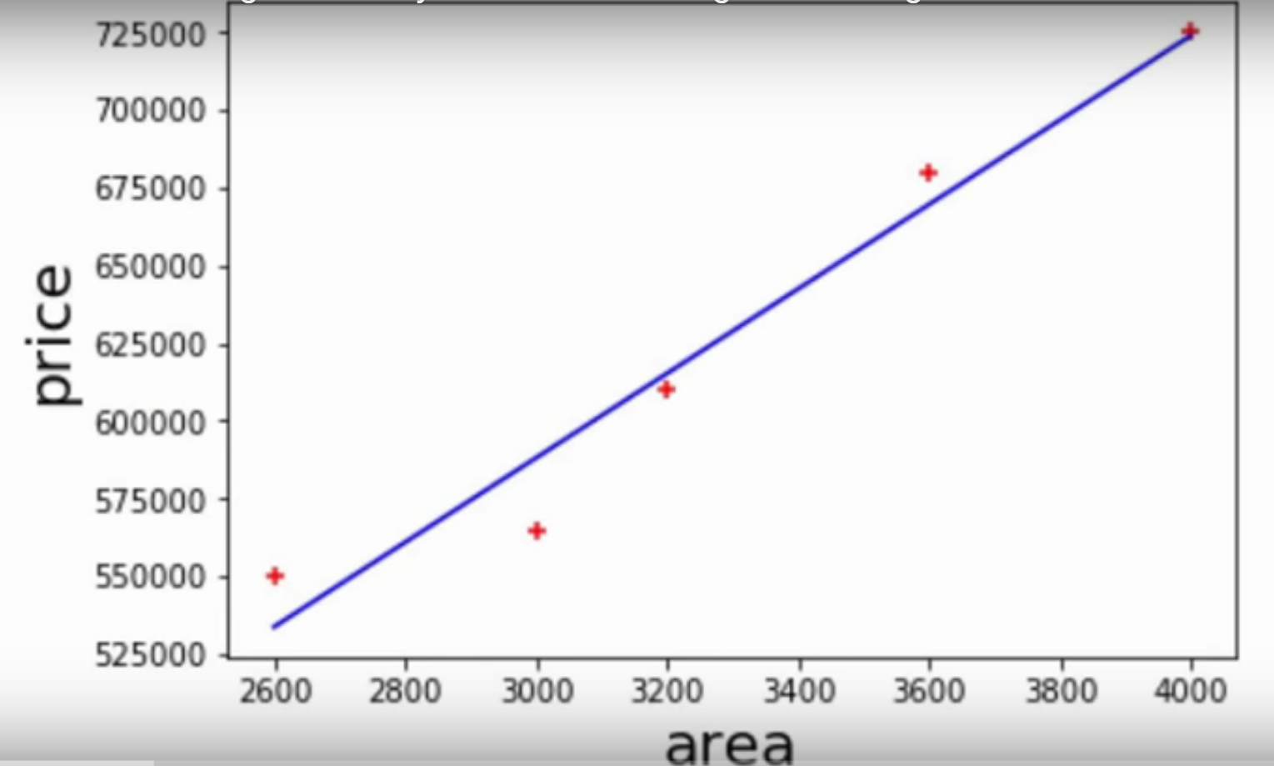
Linear Regression – Single Variable
Prediction of home price

Slide 7
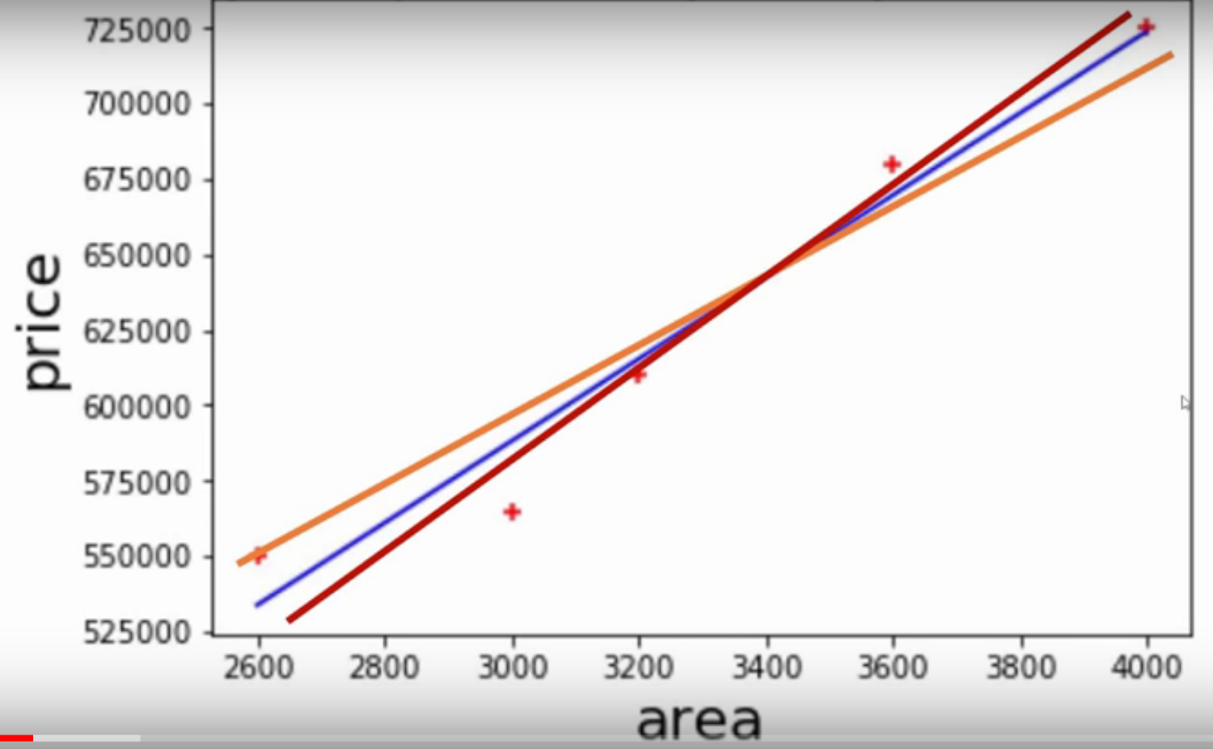
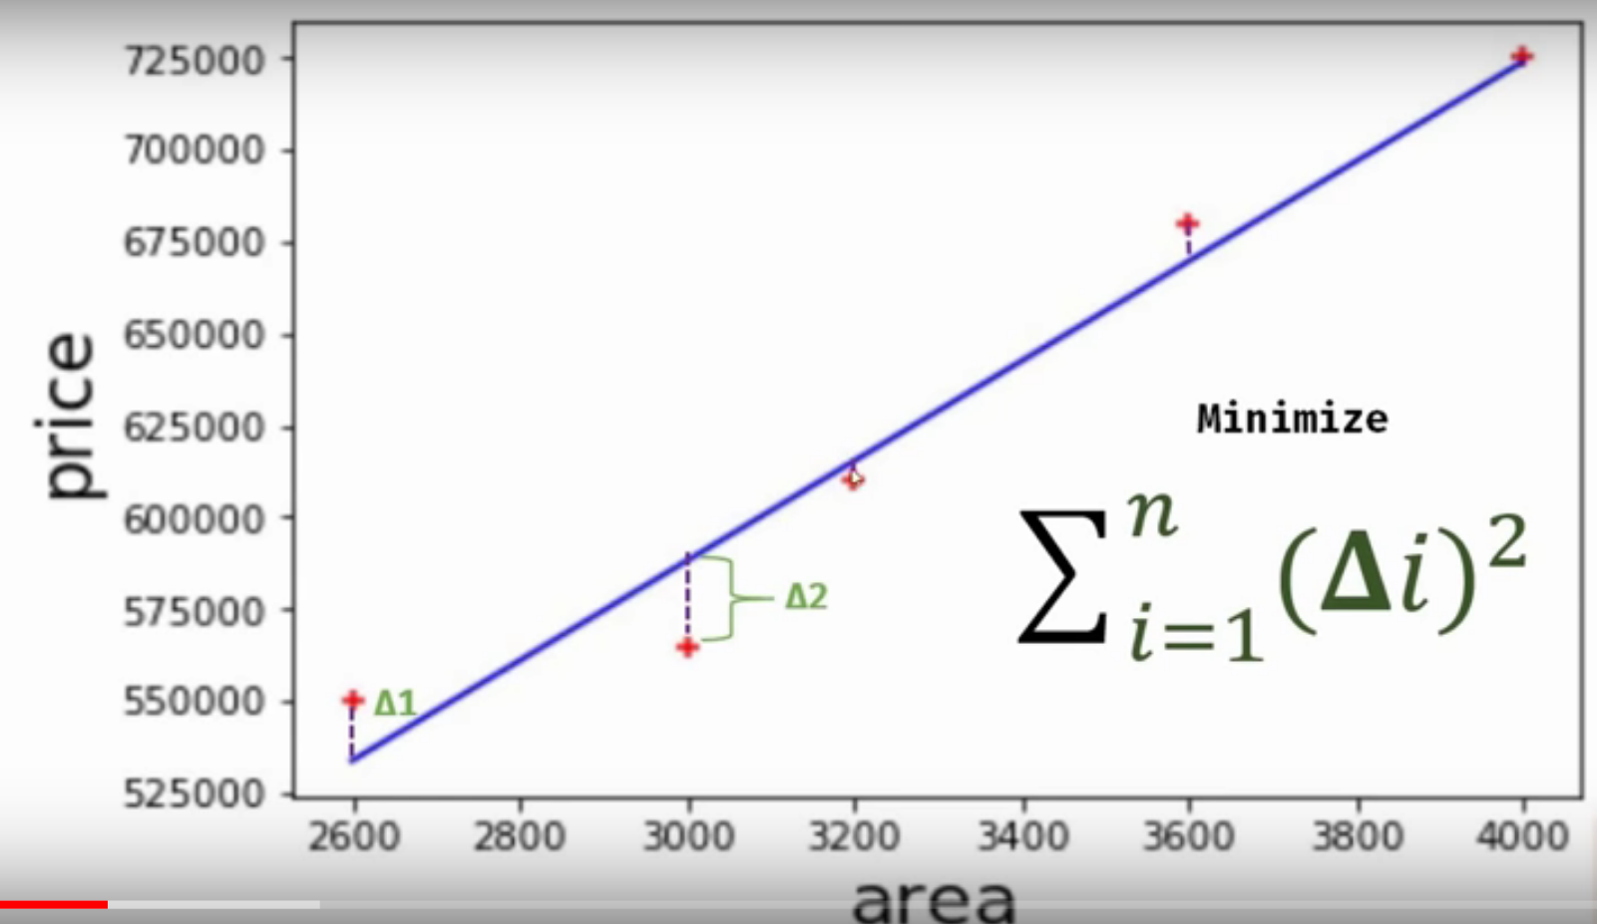
Linear Regression – Single Variable
Bestfit line

Slide 8
Linear Regression – Single Variable
Bestfit line

Slide 9
Linear Regression – Single Variable
Bestfit line

Slide 10
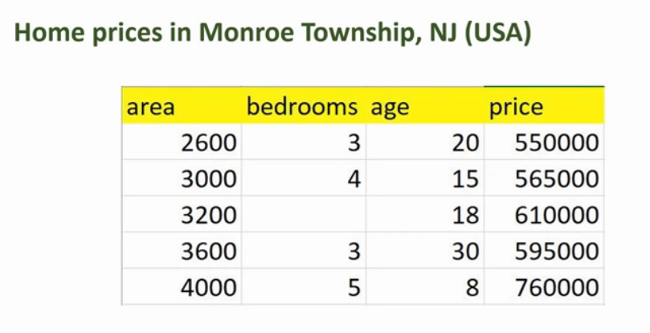
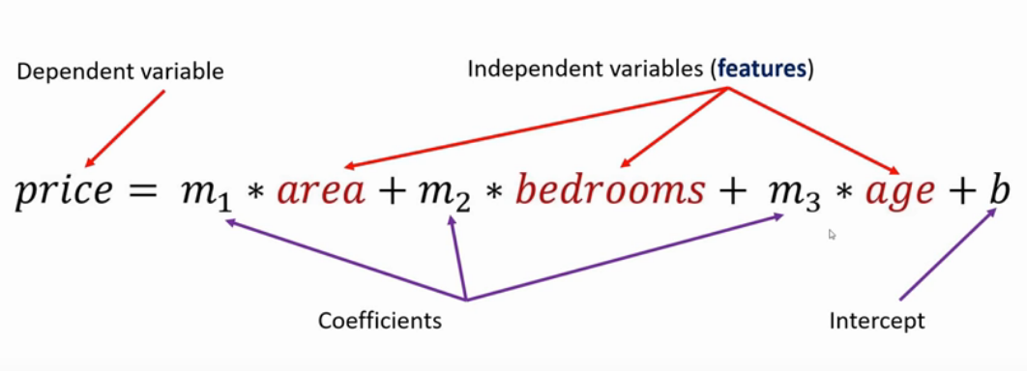
Linear Regression – Multiple Variable
Home price

Slide 11
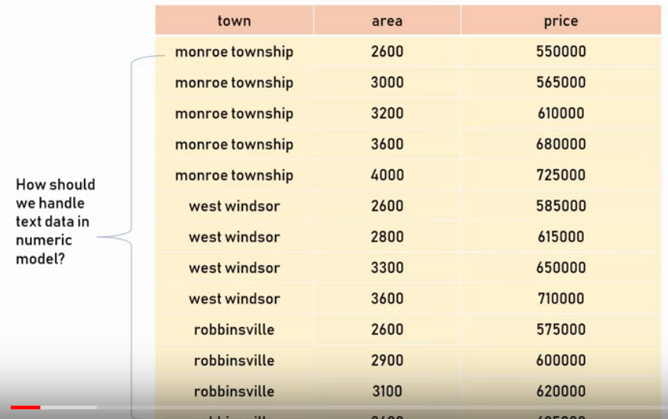
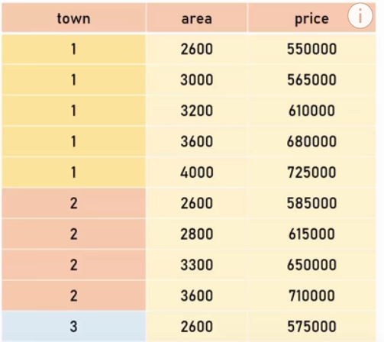
Dummy Variables – One Hot Encoding
Using Pandas – get_dummies
Using sklearn – OneHotEncoding

Slide 12
Dummy Variables – One Hot Encoding
Using Pandas – get_dummies
Using sklearn – OneHotEncoding

Slide 13
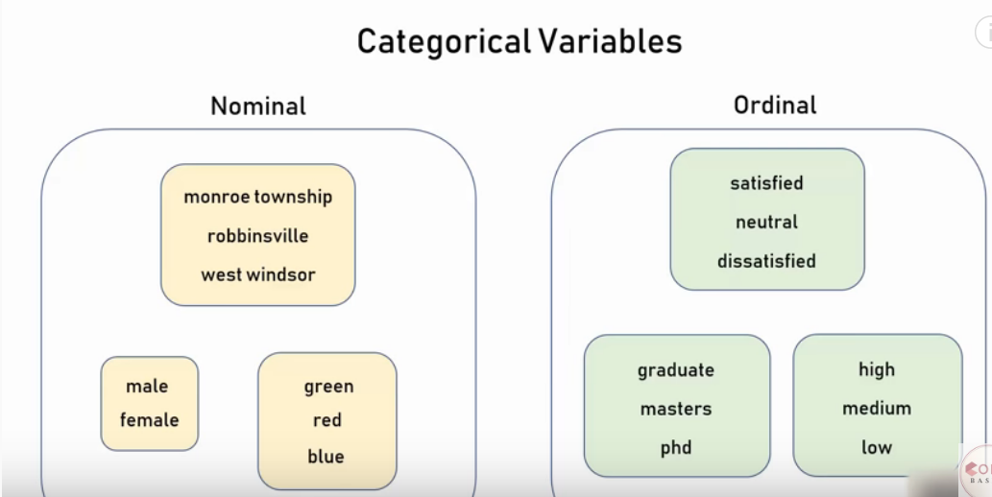
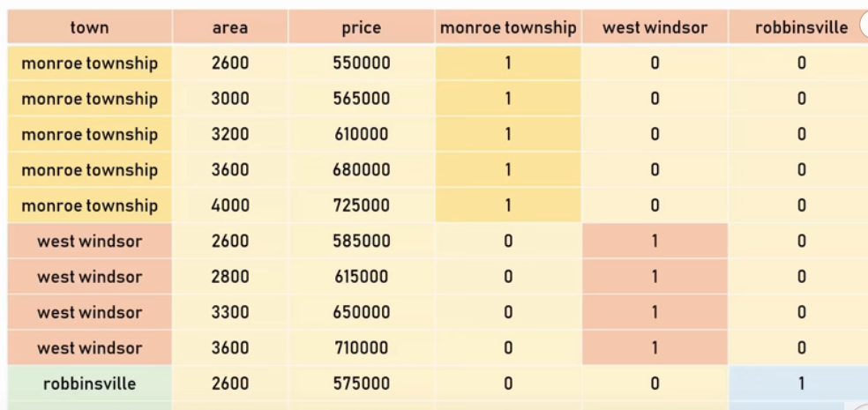
Dummy Variables – One Hot Encoding
Using Pandas – get_dummies
Using sklearn – OneHotEncoding

Slide 14
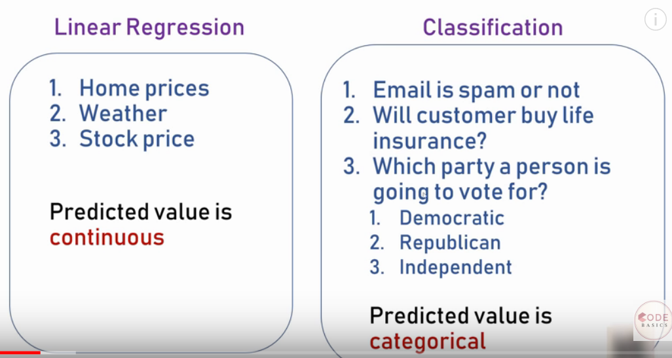
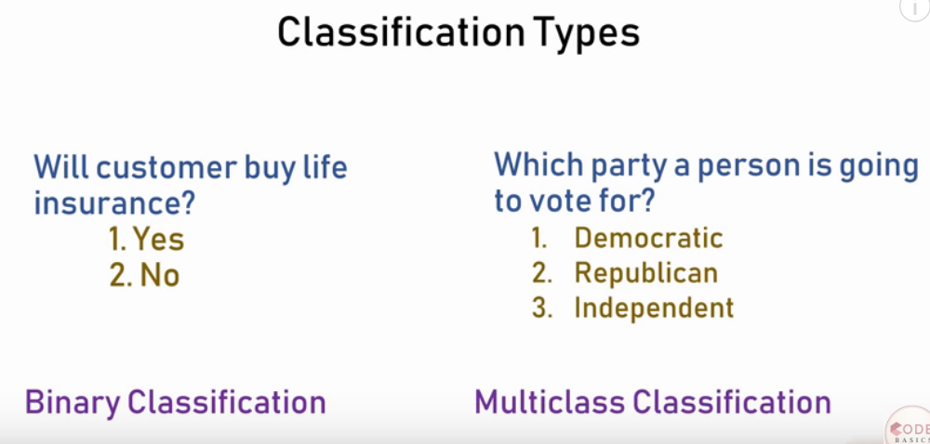
Logistic Regression – Binary Classification

Slide 15
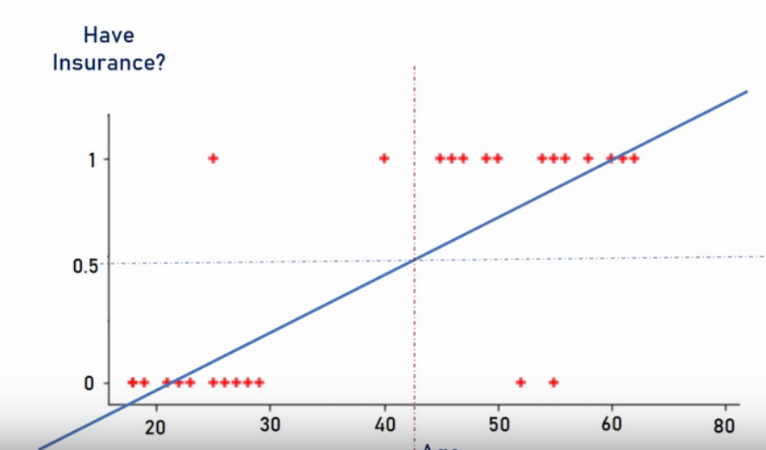
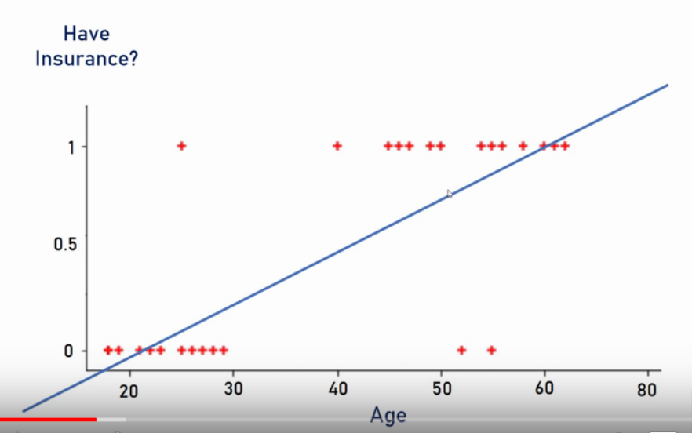
Logistic Regression – Binary Classification

Slide 16
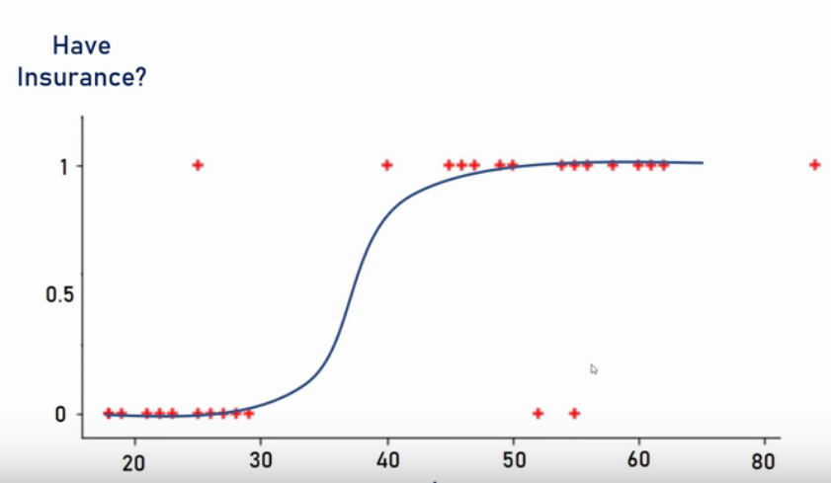
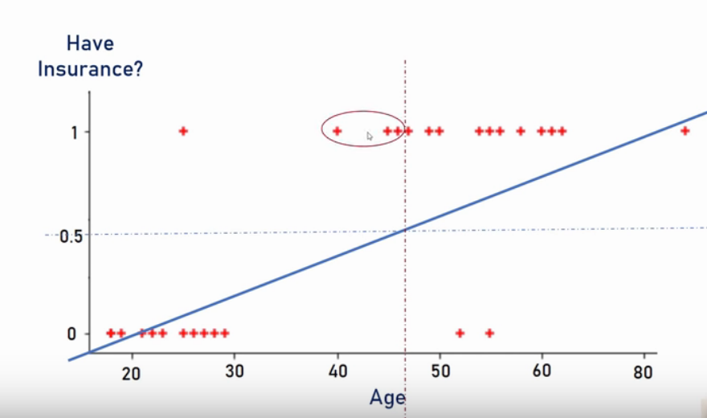
Logistic Regression – Binary Classification

Slide 17
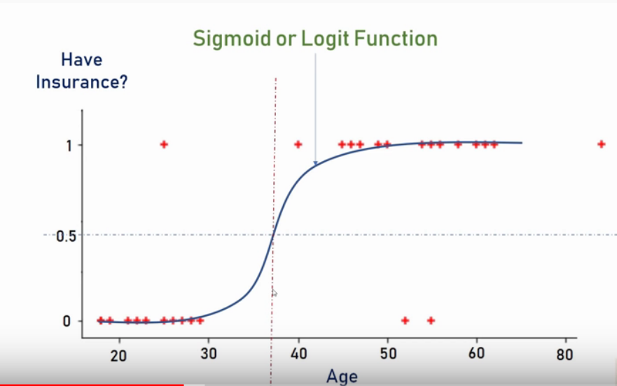
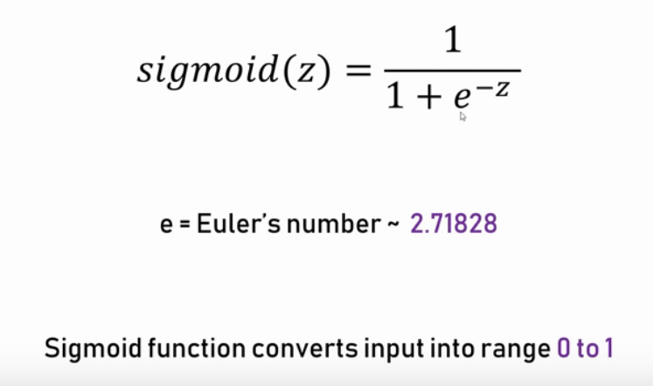
Logistic Regression – Binary Classification

Slide 18
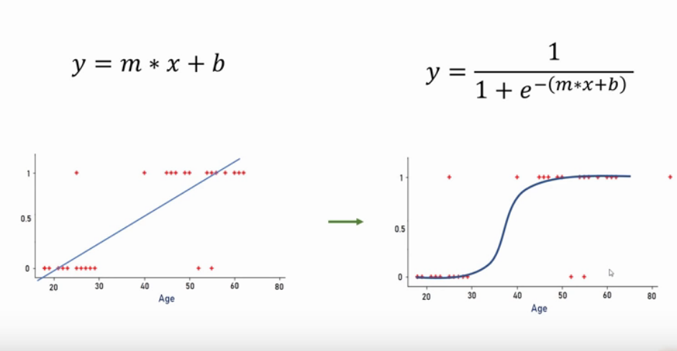
Logistic Regression – Binary Classification

Slide 19
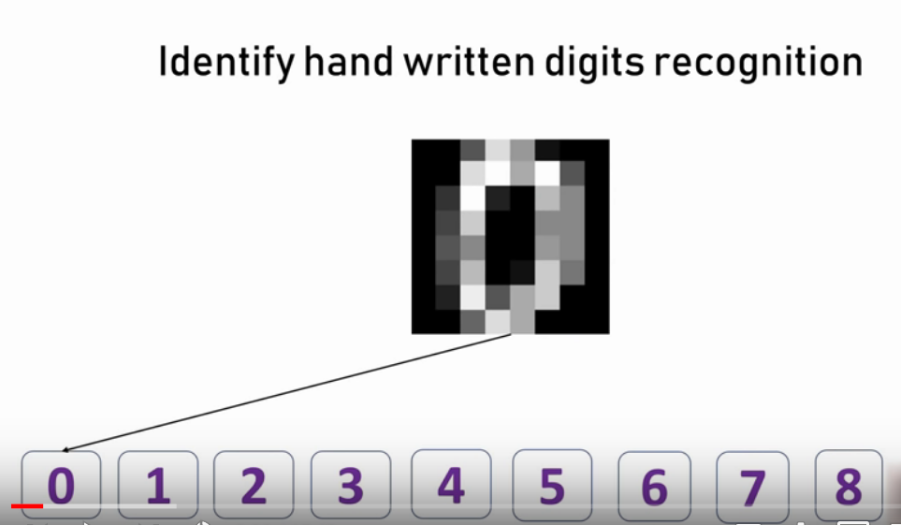
Logistic Regression – Multiclass Classification

Slide 20
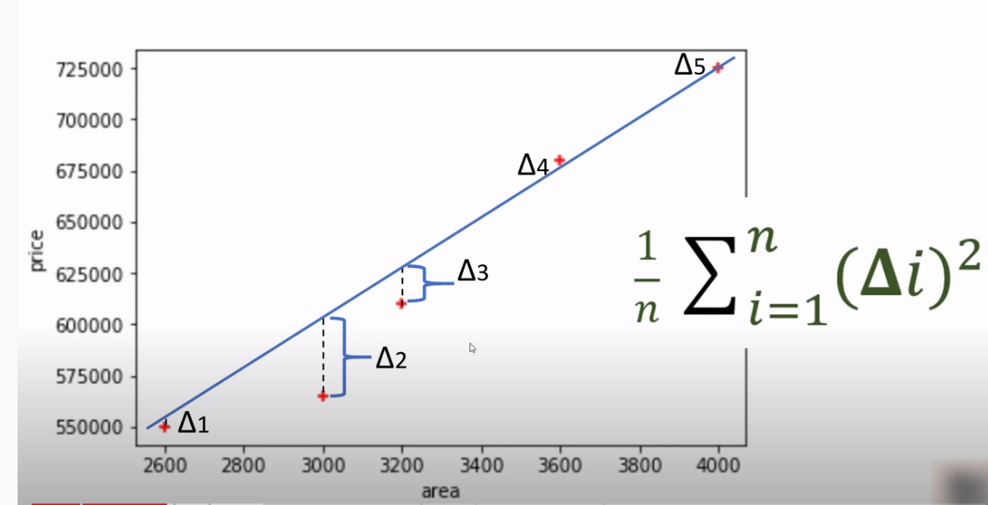
Gradient Descent

Slide 21
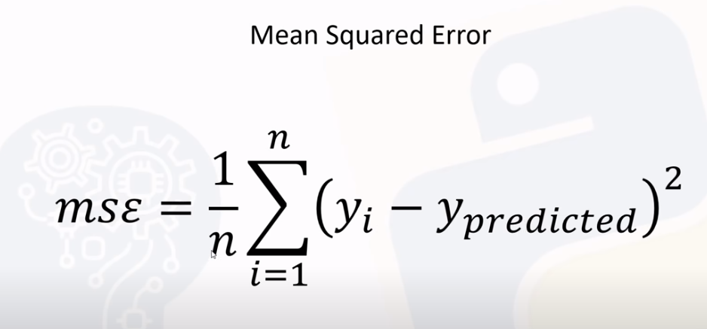
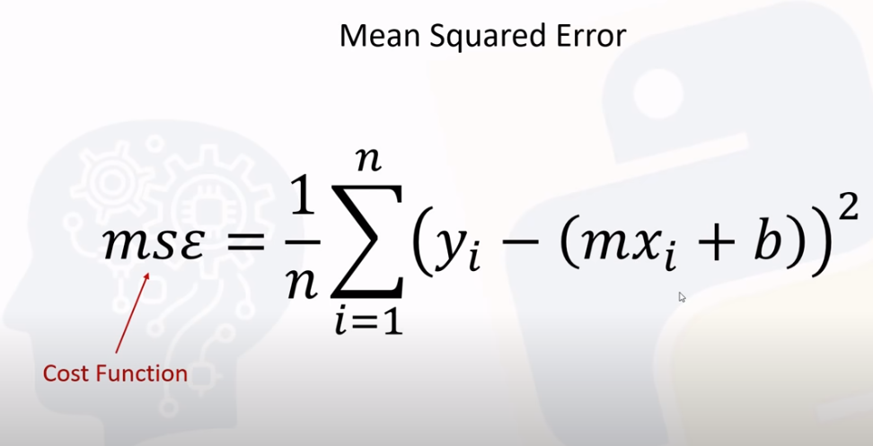
Gradient Descent

Slide 22
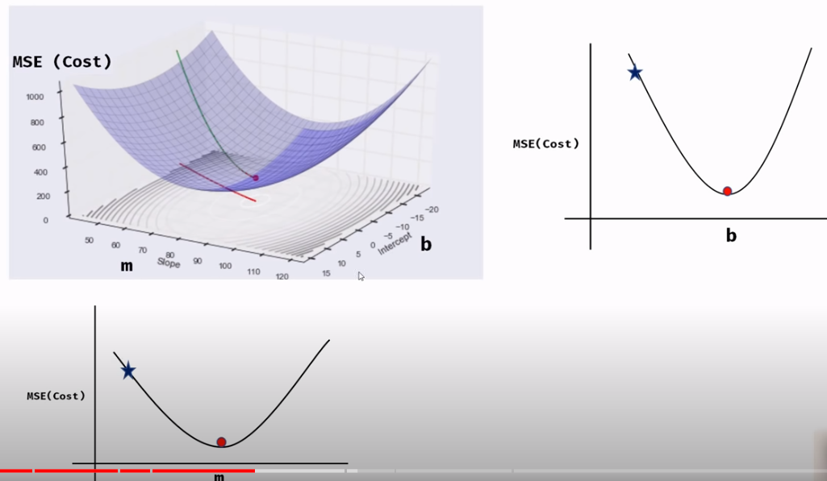
Gradient Descent

Slide 23
Gradient descent
An algorithm to minimize a function by optimizing parameters
Example – Maths test max marks 50
Guess marks – 40. Its too much
Guess marks – 30 .Its too less
Guess marks – 35 .. Correct
New Value = Old Value – step size
Step size = Learing rate* slope

Slide 24
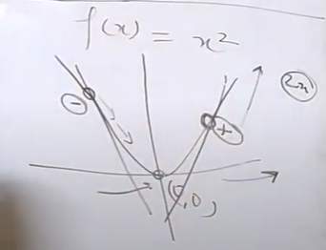
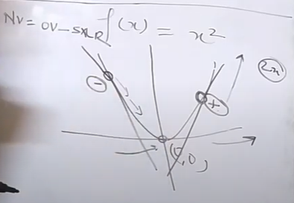
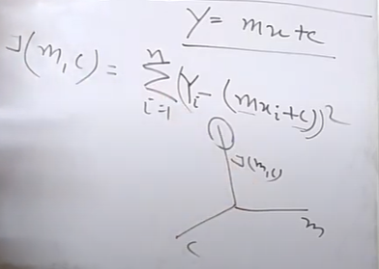
Gradient descent

Slide 25
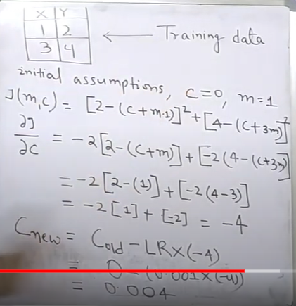
Gradient Descent

Slide 26
Metrics In Classification
1. Confusion Matrix
2. False Positive Rate – FPR (Type 1 Error)
3. False Negative Rate – FNR (Type 2 Error)
4. Recall (TPR,Sensitivity)
5. Precision (+ve Prod Val)
6. Accuracy
7. F1 Score (F Beta)
8. Cohen Kappa
9. RoC Curve,AUC Score
10. PR Curve

Slide 27
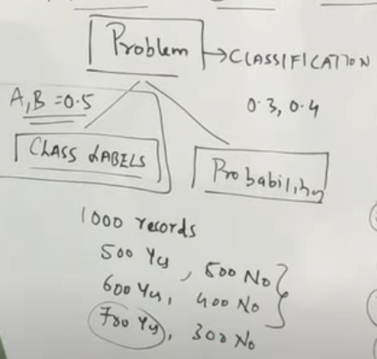
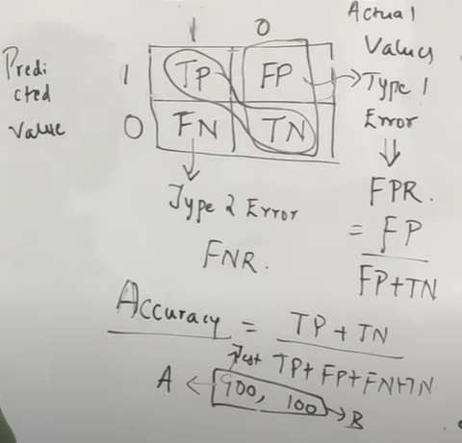
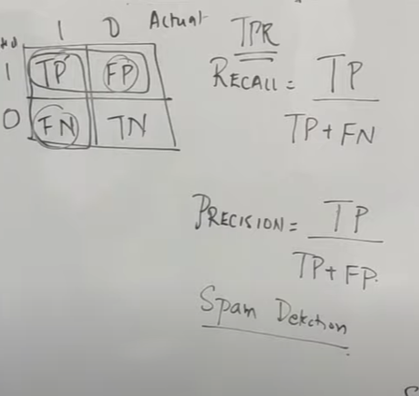
Metrics In Classification

Slide 28
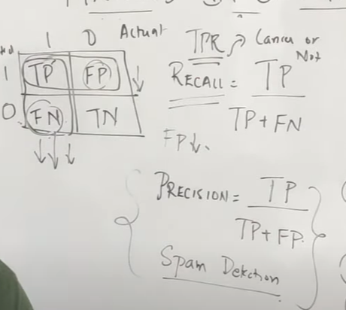
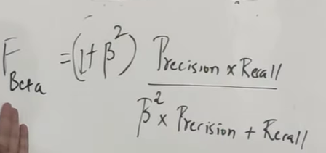
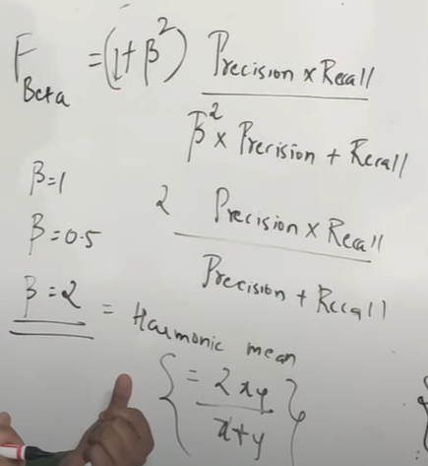
Metrics In Classification

Slide 29
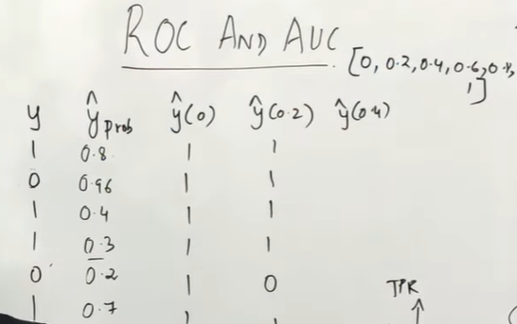
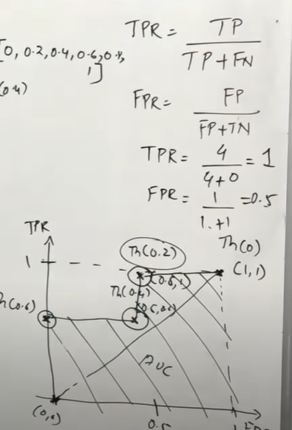
Metrics In Classification

Slide 30
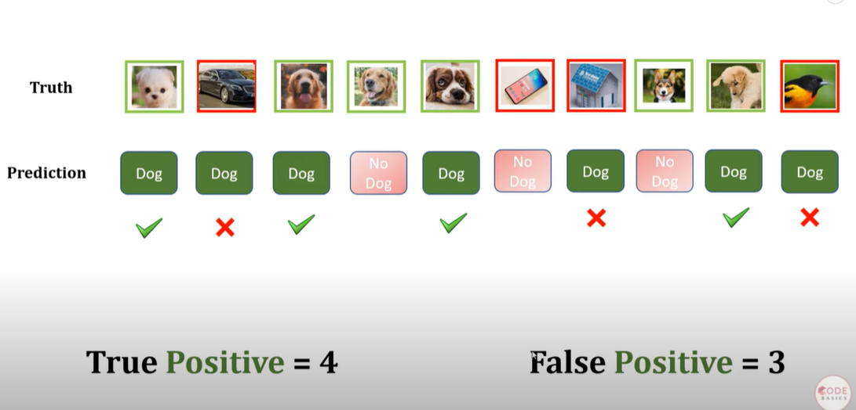
Precision,Recall,F1 Score

Slide 31
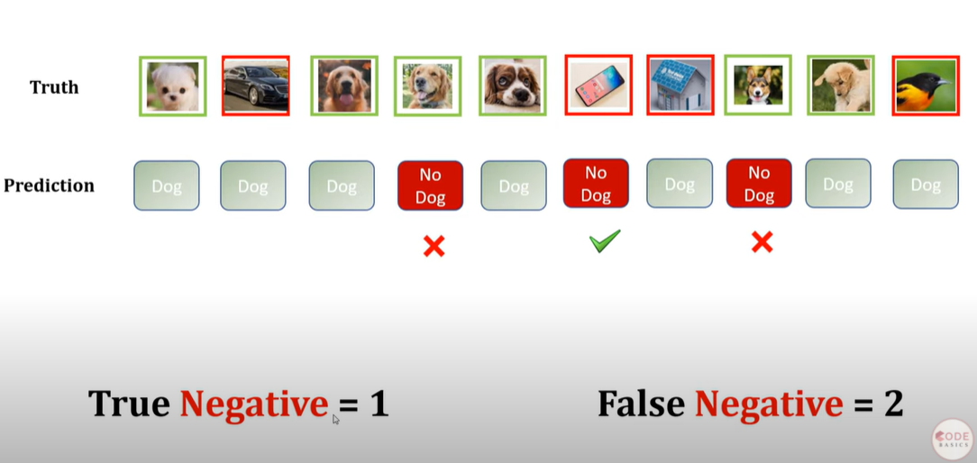
Precision,Recall,F1 Score

Slide 32
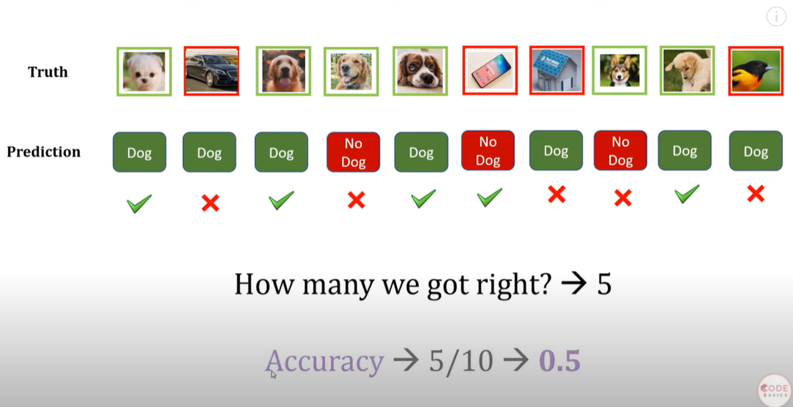
Precision,Recall,F1 Score

Slide 33
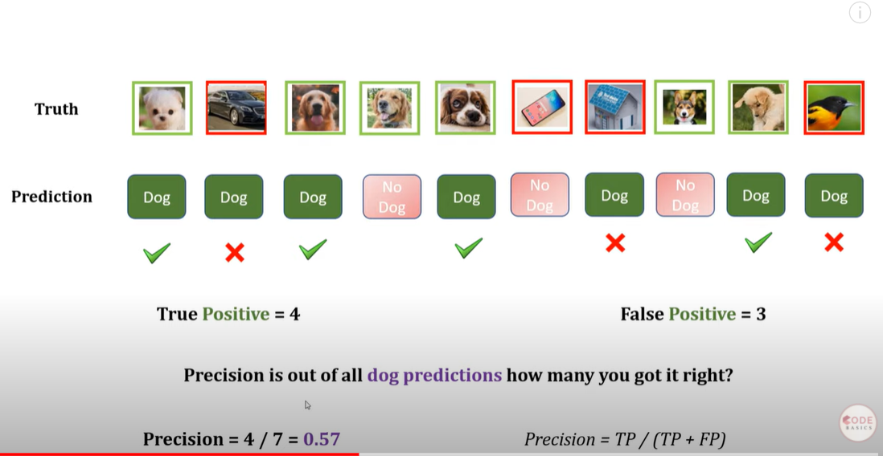
Precision,Recall,F1 Score

Slide 34
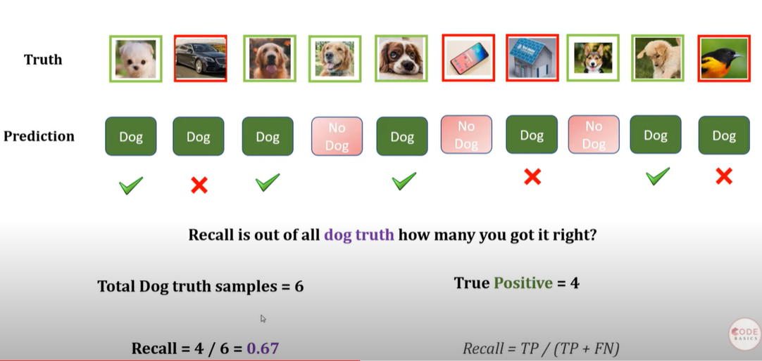
Precision,Recall,F1 Score

Slide 35
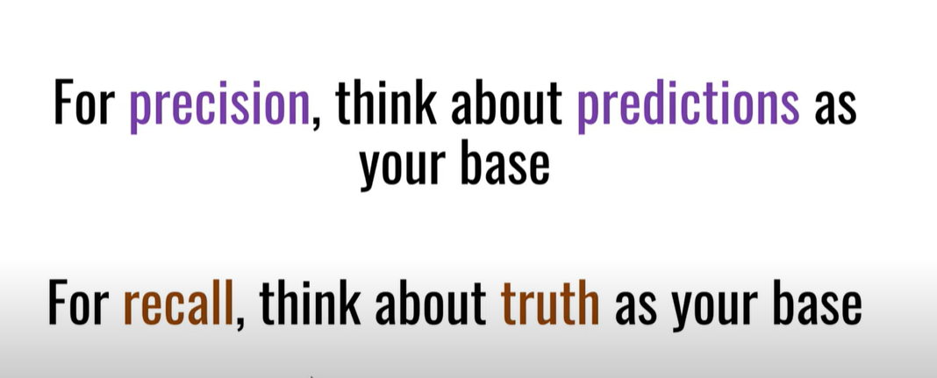
Precision,Recall,F1 Score

Slide 36
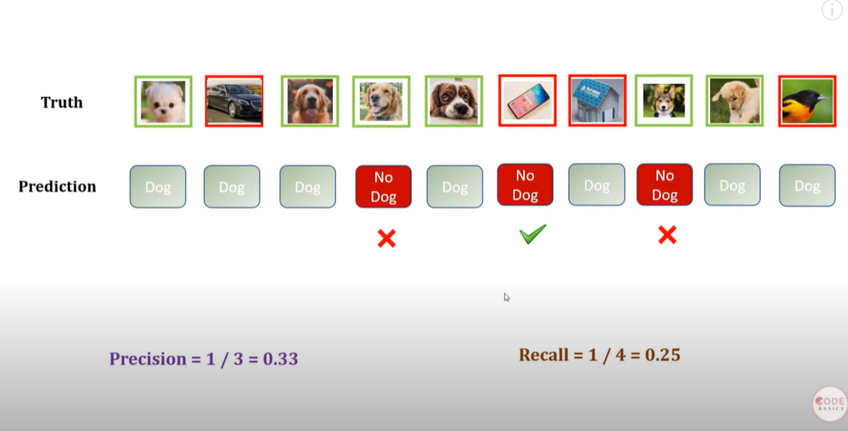
Precision,Recall,F1 Score

Slide 37
F1 Score
F1=2*(Precision*Recall)/(precision+recall)

Slide 38
Hands-on session
Linear Regression
Logistic Regression

Slide 39
References
https://www.skillbasics.com/
3Blue1BrownSeries
https://www.youtube.com/watch?v=IHZwWFHWa-w

Slide 40
Thank You
Raghu Prasad Konandur
9845547471
www.kaushalya.tech
raghuprasadkonandur@kaushalya.tech

